Slide 1

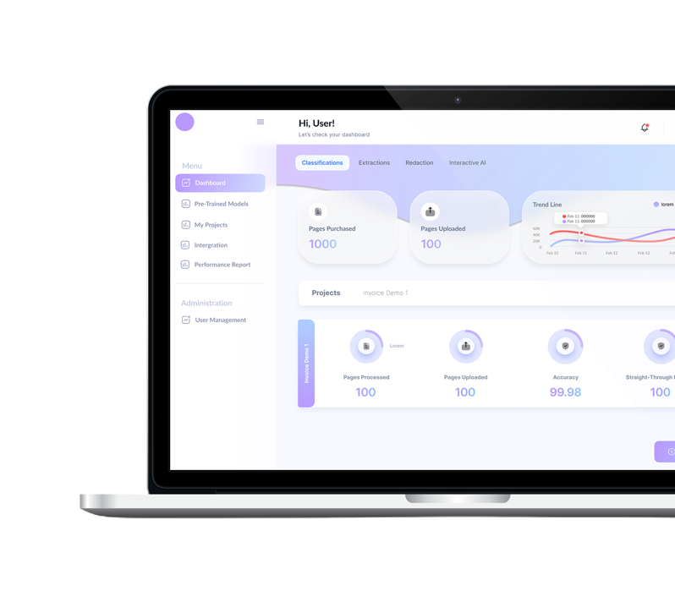
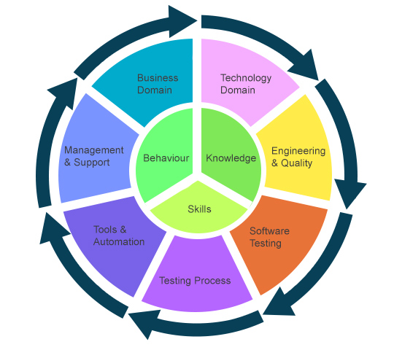
A Niche Insurance Technology Services Provider (Operating under NDA / Stealth mode for the next 1 year)
North America IT Services Acquisition
Automation and full-stack engineering specialist with 100% revenue from North American enterprise clients
Team Size
Revenue Mix
New Offices
68 Skilled Employees
100% North America
2 (Bengaluru + Locations)
Strategic Rationale
Geographic Expansion
Strengthens North American market presence with established client base
Revenue Quality
Predictable revenues with strong pricing and high profitability
UI SCREEN NEEDED
Leadership Addition
Senior leadership strengthens management team and drives growth
IP / Technology
Proprietary tools and strategic IP acquired, including frameworks
Talent Synergies
Complementary tech stack and domain expertise in automation
Domain Focus
Rich Insurance expertise
with pre-built use cases
Notes:
Mention that owing to NDA requirements – we are in stealth mode

